Slide 1


Entrepreneurial Skills
The Scope of Work & Finances

Slide 2
The scope of work (SOW) in entrepreneurial projects refers to a detailed document that outlines the specific tasks, deliverables, milestones, and criteria for success within a project. It acts as a roadmap, defining the boundaries and parameters of the project to guide both the project team and stakeholders. The scope serves as a contractual agreement between the entrepreneur and relevant parties, setting clear expectations for what will be accomplished.
Key components ->

Slide 3
Definition and Importance

Slide 4

Tasks and Activities
Deliverables
A well-defined scope of work must have all the tasks and activities identified and listed as necessary to achieve project objectives. Why? The tasks identified will help the project team and stakeholders understand what they are expected to do. In other words, it defines the specific actions required to deliver the project objectives.
The scope of work should clearly specify the tangible outputs or results expected from the project. Deliverables can include physical products, reports, documentation, or any other work product the project is designed to produce. By defining these expectations upfront, the project team can work more efficiently and effectively and avoid any misunderstandings or disputes later on.

Slide 5
Timeline
Milestones
To track progress and achievements, one cannot forget to establish critical points in the project timeline.
The timeline helps ensure that the project stays on track and that everyone involved understands what is expected of them. However, one should not forget that to create a ‘timeline’ part, one needs to consider different types of factors, such as the complexity of the project, resources, or any kind of external factors.

Slide 6
Budget
Quality Standards
This part focuses on the level of excellence that the project’s deliverable should meet. Such standards are often defined by various requirements but, most importantly, the client’s expectations. The manager or the team should regularly assess if all the deliverables meet the outlined quality standards.
To have a well-defined scope of work, one needs to include a clear and detailed project budget outline. However, the budget needs to be carefully defined and considered to ensure success. Therefore, what will help in outlining the budget part is a careful analysis of every task and deliverables and considering any potential risks.

Slide 7
Constraints
The last key element of a professional scope of work is outlining any limitations or restrictions that may impact project execution. Why? It might have a significant impact on the project’s timeline and budget. Therefore, it is important to analyse every small detail beforehand and identify any potential limitations, such as the number of team members, equipment, or resources.

Slide 8
Development of the Scope of Work

Slide 9
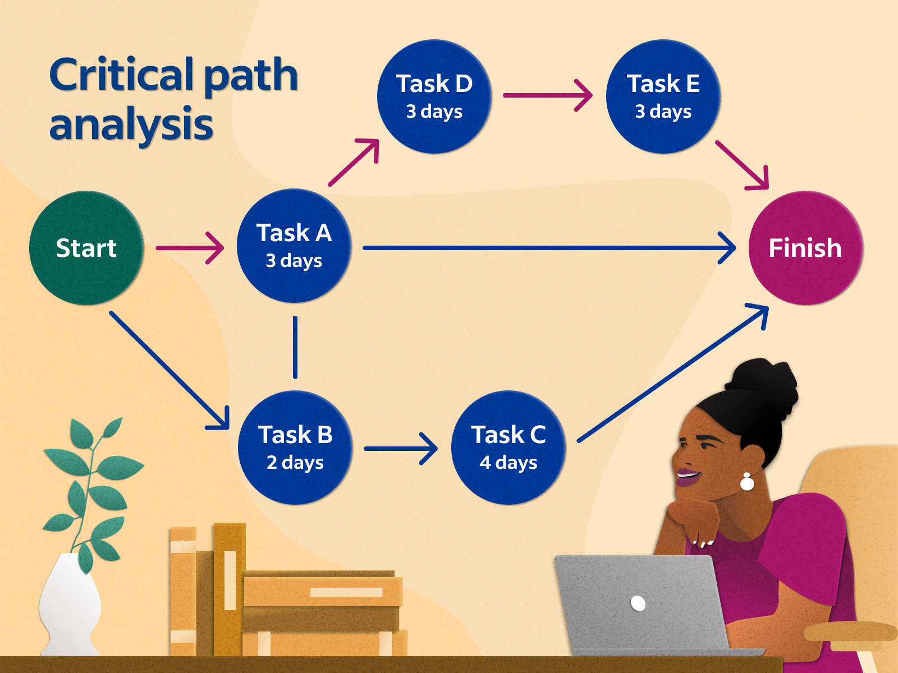
Techniques for Effective
Project Planning
1. Critical Path Analysis is a technique that identifies the sequence of tasks crucial to determining the shortest possible duration for project completion.
Project managers can focus on tasks that directly impact the project timeline by determining the most important path. This method aids in prioritising tasks, optimising resource allocation, and mitigating delays. This technique is particularly valuable for complex projects with interconnected tasks; it will help ensure that the project stays on track for timely delivery.

Slide 10
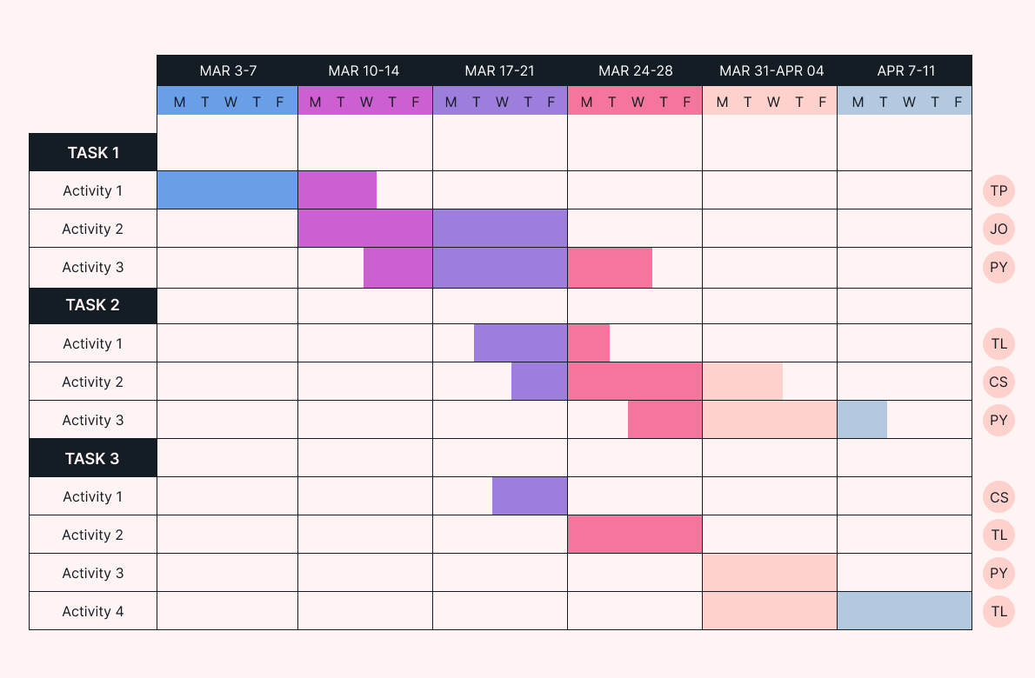
Techniques for Effective
Project Planning
2. Gantt Charts
These charts illustrate the project schedule, enabling project managers to identify task dependencies and allocate resources effectively. Gantt Charts also provide a clear timeline, helping teams understand the sequence of tasks and deadlines. This visualisation fosters efficient resource management and allows for quick adjustments to the project schedule as needed.

Slide 11
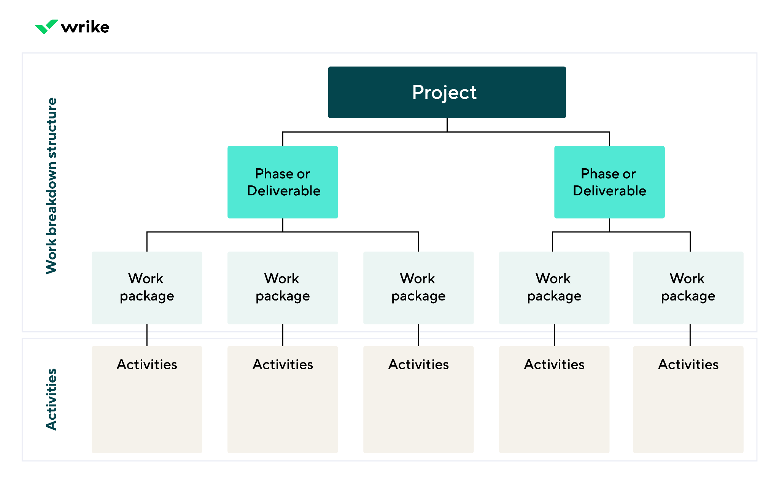
Techniques for Effective
Project Planning
3. The Work Breakdown Structure (WBS) is a fundamental technique that breaks the entire project into smaller, more manageable components. Such a hierarchical decomposition visually represents the project's scope, allowing project managers to understand the relationships between different tasks and their contribution to the objectives. By systematically organising tasks into levels, this technique ensures that no aspect of the project is overlooked.

Slide 12
Task Identification and Breakdown
A foundation of an effective task identification is the active engagement of stakeholders. By involving relevant stakeholders from various departments or areas of expertise, project managers can gain valuable knowledge and address potential challenges early in the planning phase.
One should learn about the task dependency analysis, which involves identifying how tasks are interconnected and determining their dependencies. By recognizing which tasks are dependent on others and which can be conducted concurrently, project managers can optimise resource allocation, streamline project timelines, and mitigate potential delays.
The mind mapping is a powerful technique that utilises visual diagrams to explore and connect different tasks associated with project goals. This creative and nonlinear approach encourages brainstorming and the identification of tasks that may not be immediately apparent in a traditional linear format.

Slide 13
Management of the Scope of Work

Slide 14
Strategies for Managing
Scope Changes
1. Effective Communication
By transparently explaining the motives behind scope changes, it promotes comprehension and collaboration.
Such a type of communication guarantees that all parties understand the need for change, reducing confusion, resistance, and possible disruptions.
Maintaining open channels of communication fosters a culture of trust and accountability, establishing a sturdy groundwork for the success of the project.

Slide 15
Strategies for Managing
Scope Changes
2. Impact Assessment
It involves a comprehensive evaluation of how modifications may affect project timelines, budgets, and resources.
By systematically analysing the potential consequences, project managers can make well-informed choices and proactively address challenges that may arise.
This approach ensures that the project remains on track and that adjustments are made with a clear understanding of their broader implications.

Slide 16
Strategies for Managing
Scope Changes
3. Change Control Procedures
By introducing a systematic approach, project managers can ensure that proposed changes align with project objectives, are carefully assessed, and have the necessary approvals in place before implementation.
This not only maintains the integrity of the project but also facilitates a more controlled and organised adaptation to evolving requirements.

Slide 17
Risk Response Planning
Scenario analysis prompts project teams to envision a range of potential situations, allowing them to identify blind spots and develop flexible response strategies. By encouraging project managers to think creatively and strategically, this approach enhances the project's overall readiness and responsiveness to unforeseen circumstances.
Identification and assessment of potential risks. Regular scrutiny of the project landscape enables project managers to anticipate challenges that may impact the project scope. Through a thorough risk assessment, project teams categorize and prioritize potential threats, fostering a proactive mindset that enables timely and targeted responses.
The development of contingency plans. Contingency planning involves the creation of proactive strategies to address anticipated risks and challenges. Such plans may include alternative approaches, resource reallocation, or predefined actions, ensuring that the project can adapt swiftly and effectively to unforeseen circumstances.

Slide 18





"The European Commission's support for the production of this publication does not constitute an endorsement of the contents, which reflect the views only of the authors, and the Commission cannot be held responsible for any use which may be made of the information contained thereinProject Number: 2022-1-DE-KA220-ADU-000086609

