Slide 1






MARKETING

Slide 2

AIMS
This unit empowers giggers with modern marketing skills, where the focus is on relationships and client connections.
Learners will identify strategic areas of marketing communications that are critical for success in the Gig work environment.

Slide 3
Knowledge Areas
  Principles of relationship marketing and its role in building lasting customer connections.
  The significance of brand storytelling.
  Content marketing strategies to engage and inform target audience.
  Social media engagement techniques to foster direct interactions and community building.
  Customer segmentation and its impact on tailoring marketing strategies.

Slide 4
Modern Marketing
To be successful in business companies are
moving beyond traditional marketing
approaches and embracing innovative strategies that focus on establishing enduring connections
with their customers.

Slide 5

Relationship Marketing is about nurturing long-term relationships with customers.
It's built on trust, communication, and mutual understanding."

Slide 6
1. Personalisation: Understanding what customers like and delivering tailored content.
2.Customer Engagement: Creating meaningful interactions for loyalty and emotional investment."
The Paradigm Shift
From Transactions to Relationships

Slide 7
The Paradigm Shift
Brand Storytelling
"Brand Storytelling creates stories that make brands come alive and connect with people on an emotional level, going beyond simple business transactions."

Slide 8


At the core of brand storytelling is the ability to create a narrative arc that
engages and captivates the audience.
The Paradigm Shift
Brand Storytelling

Slide 9
The Paradigm Shift
Story Telling Tips
1. Start with your brand's core values and mission.
2.Identify your target audience.
3.Use emotion to create a connection.
4.Keep it simple and focused.
5.Be authentic."

Slide 10
Immersive Brand Experiences
Brand immersion is simply taking the idea of brand activation to its logical completion and fully branding a space so that any customer who enters the zone of immersion gets to interact with brand ideas, ideals, and concepts while present.

Slide 11

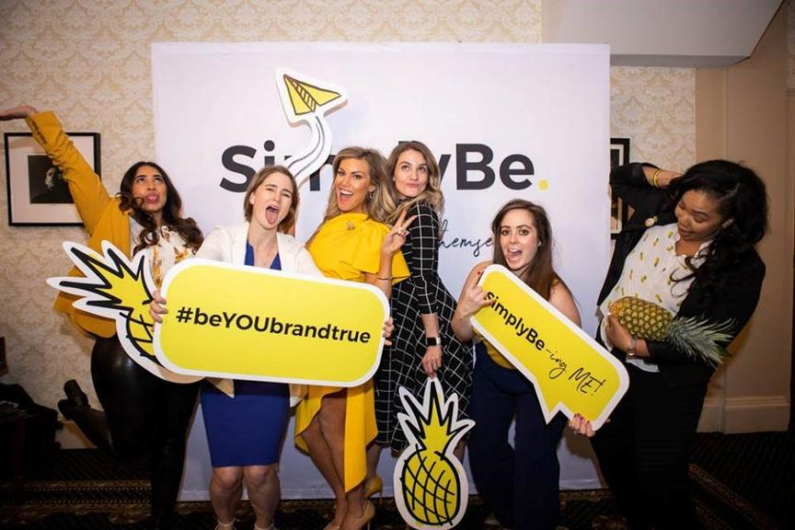


The 3 E’s of Immersion
There are three “E”s that embody the nature of a successfully activated brand immersion campaign:
Educated: The customer knows about the product,
Engaged: The customer gets involved in the experience.
Excited: Customers share the story of their interaction with others.

Slide 12
Experiential Marketing
Experiential marketing is a way of engaging a brand’s customers via live interaction. It is a surefire way to build brand awareness and brand affinity, boost brand recognition, attract new customers, and have current customers come back for more.

Slide 13
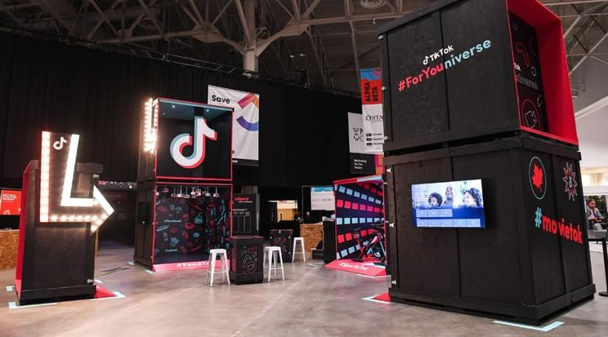
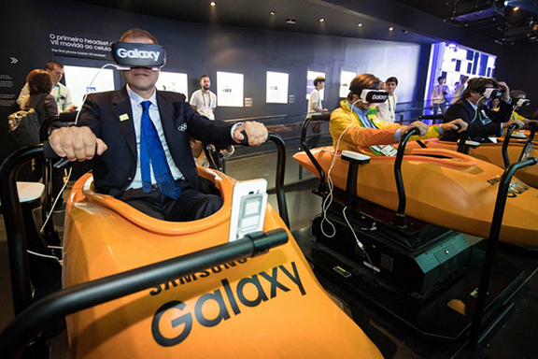
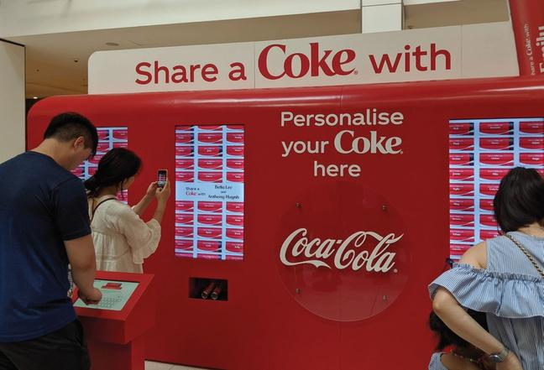
Experiential Marketing
Road Shows

Slide 14


Experiential Marketing Example 2
Fans can come and visit, sit on the infamous orange couch, and (most importantly) take an Instagram photo to share with their friends.
This experience marketing allows Friends fans to relive their love of the hit TV show. It creates the experience of being part of the show .
Friends Cafe in New York

Slide 15
Data Driven Customer Insights
Data-driven marketers use customer data to predict their needs, desires and future behaviours. Such insight helps develop personalised marketing strategies for the highest possible return on investment

Slide 16
Digital Communication Strategies
Content Marketing, Social Media Engagement, SEO Optimisation, and Thought Leadership are essential strategies in the digital age."

Slide 17
Content Marketing
Content marketing is a marketing strategy used to attract, engage, and retain an audience by creating and sharing relevant articles, videos, podcasts, and other media. This approach establishes expertise, promotes brand awareness, and keeps your business top of mind when it's time to buy what you sell.

Slide 18










ACTIVITY - Top Social Media Platforms
Can you guess their names from these logos?

Slide 19
Measuring Success and Optimisation
Key Performance Indicators (KPIs) stand as quantifiable metrics that enable marketers to gauge the effectiveness of their efforts. These metrics offer a tangible way to assess various aspects of a campaign's performance, ranging from customer engagement to conversion rates. One crucial KPI is the Conversion Rate, which tracks the percentage of visitors who take a desired action, such as making a purchase or signing up for a newsletter.

Slide 20











VISIT US AT giggersproject.eu
"The European Commission's support for the production of this publication does not constitute an endorsement of the contents, which reﬂect the views only of the authors, and the Commission cannot be held responsible for any use which may be made of the information contained thereinProject Number: 2022-1-DE-KA220-ADU-000086609

